Slide 1
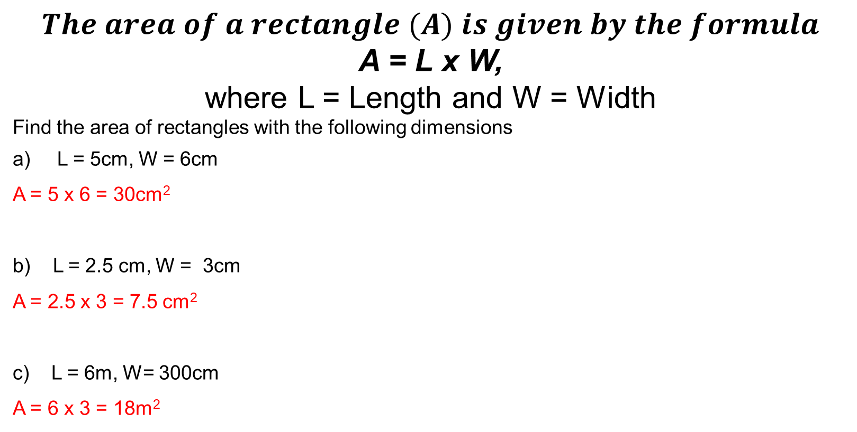
Daily Review
CFU
Convert 300 cm into metres
(Hint: 100cm = 1m)
Substitute into the following formulas
$$The area of a rectangle (A) is given by the formula$$
A = L x W,
where L = Length and W = Width
Find the area of rectangles with the following dimensions
L = 5cm, W = 6cm
A = 5 x 6 = 30cm²
b) L = 2.5 cm, W = 3cm
A = 2.5 x 3 = 7.5 cm²
c) L = 6m, W= 300cm
A = 6 x 3 = 18m²

Slide 2




Daily Review
The speed (s) of an object can be given by the formula:
$s=\frac{d}{t}$
where s= speed in metres per second, d = distance travelled in metres, t = time taken to travel distance in seconds
Calculate the value of s when:
d = 100 , t = 10
$s=\frac{100}{10}$
s = 10 m/s
2. d = 220 , t = 11
$s=\frac{220}{11}$
s = 20 m/s
3. d = 350 , t = 60
$s=\frac{350}{60}$
s = 5.8$\dot{3}$ m/s
4. d = 12.5 , t = 25
$s=\frac{12.5}{25}$
s = 0.5 m/s

Slide 3

Daily Review
Worded problem
A Zoo sells tickets that costs $10 for children and $15 for adults.
The total money (M) received by the zoo is given by the formula:
M = 10c + 15a,
where c = number of children and a = number of adults
How much money will the zoo make if:
a) 250 children and 300 adults visited the zoo?
M = 10 (250) + 15(300)
= 2500 + 4500
= $7000
b) 80 children and 240 adults visited the zoo?
M = 10 (80) + 15(240)
= 800 + 3600
= $4400

Slide 4
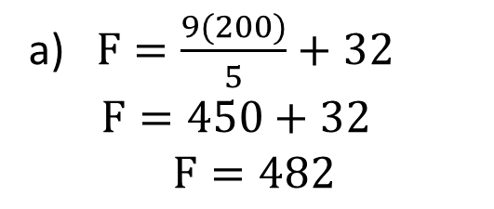
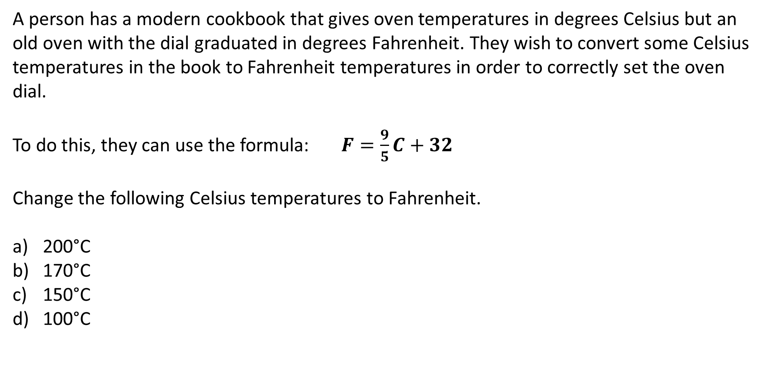
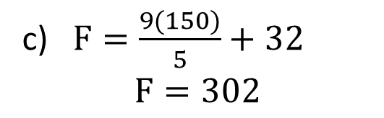
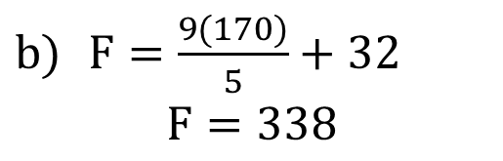
Y11 Apps Chapter 1 Situation 1
A person has a modern cookbook that gives oven temperatures in degrees Celsius but an old oven with the dial graduated in degrees Fahrenheit. They wish to convert some Celsius temperatures in the book to Fahrenheit temperatures in order to correctly set the oven dial.
To do this, they can use the formula: $F=\frac{9}{5}C+32$
Change the following Celsius temperatures to Fahrenheit.
200°C
170°C
150°C
100°C
= 482°F
a) $F=\frac{9(200)}{5}+32$
$F=450+32$
$$F=482$$
$F=\frac{9(170)}{5}+32$
$$F=338$$
c) $F=\frac{9(150)}{5}+32$
$$F=302$$
= 338°F
= 302°F
= 212°F
You do d)

Slide 5

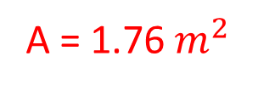
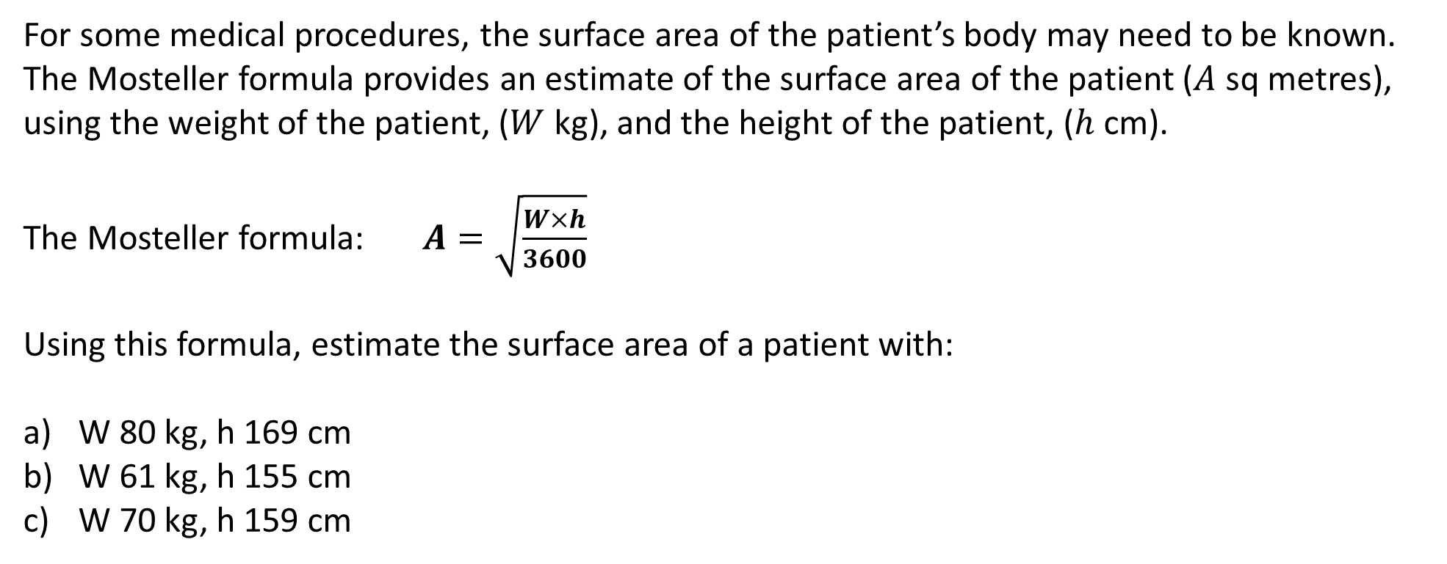
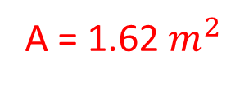
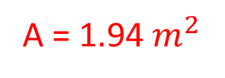

Y11 Apps Chapter 1 Situation 2
For some medical procedures, the surface area of the patient’s body may need to be known. The Mosteller formula provides an estimate of the surface area of the patient ($A$ sq metres), using the weight of the patient, ($W$ kg), and the height of the patient, ($h$ cm).
The Mosteller formula: $A=\sqrt{\frac{W×h}{3600}}$
Using this formula, estimate the surface area of a patient with:
W 80 kg, h 169 cm
W 61 kg, h 155 cm
W 70 kg, h 159 cm
$$a) A=\sqrt{\frac{(80)×(169)}{3600}}$$
$A=\sqrt{3.755555556}$
$$A=1.94$$
$$b) A=\sqrt{\frac{(61)×(155)}{3600}}$$
$$A=1.62$$
A = 1.94${ m}^{2}$
A = 1.62${ m}^{2}$
A = 1.76${ m}^{2}$
You do c)

Slide 6

Y11 Apps Chapter 1 Example 1
Formula: $A=P+I$
Find $A$given that $P=4000$ and $I=525$
Step 1: Write out the formula.
Step 2: Substitute in the known values.
Step 3: Evaluate the answer.
$$A=P+I$$
$$A=(4000)+(525)$$
$$A=4525$$

Slide 7


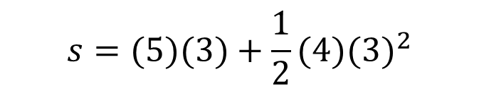

Y11 Apps Chapter 1 Example 2
Formula: $s=ut+\frac{1}{2}{at}^{2}$
Find $s$given that $u=5, t=3$ and $a=4$
$$s=ut+\frac{1}{2}{at}^{2}$$
Step 1: Write out the formula.
Step 2: Substitute in the known values.
Step 3: Evaluate the answer.
$$s=(5)(3)+\frac{1}{2}{(4)(3)}^{2}$$
$$s=15+2×9$$
$$s=33$$

Slide 8



Y11 Apps Chapter 1 Example 3
Formula: $A=250{(1.08)}^{n}$
Find $A$correct to 1 decimal places given that $n=14$
Step 1: Write out the formula.
Step 2: Substitute in the known values.
Step 3: Evaluate the answer.
$$A=250{(1.08)}^{n}$$
$$A=250{(1.08)}^{14}$$
$$A=734.298….$$
$$A=734.3 (1 d.p)$$

Slide 9
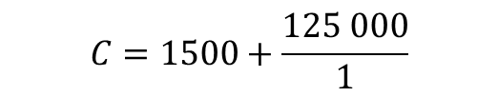
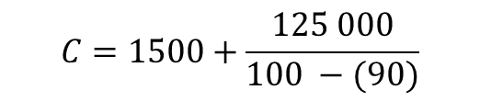
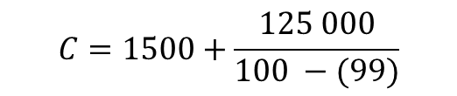
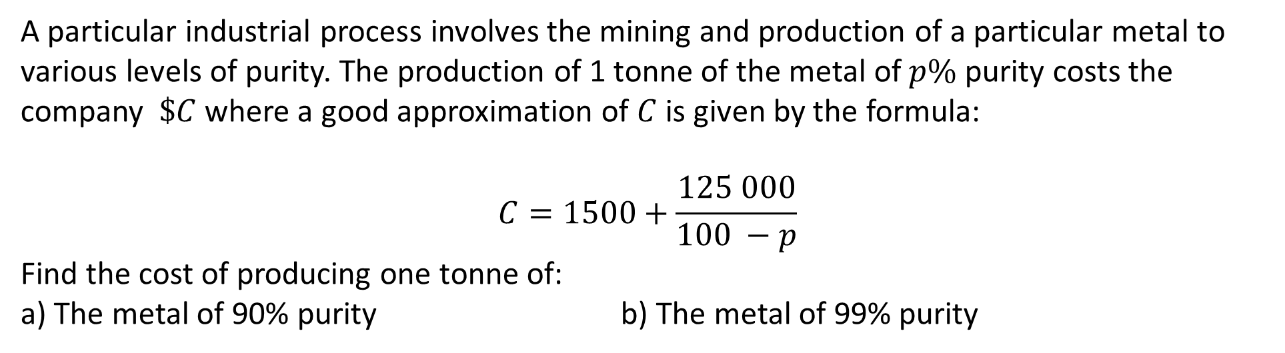



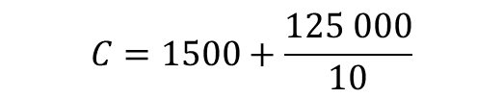

Y11 Apps Chapter 1 Example 4
Now do Exercise 1A
A particular industrial process involves the mining and production of a particular metal to various levels of purity. The production of 1 tonne of the metal of $p\%$ purity costs the company $\$C$where a good approximation of $C$ is given by the formula:
$$C=1500+\frac{125 000}{100 −p}$$
Find the cost of producing one tonne of:
a) The metal of 90% purity b) The metal of 99% purity
$$C=1500+\frac{125 000}{100 −(90)}$$
$$C=1500+\frac{125 000}{100 −(99)}$$
$$C=1500+\frac{125 000}{10}$$
$$C=1500+\frac{125 000}{1}$$
$$C=1500+12 500$$
$$C=1500+125 000$$
$$C=14 000$$
$$C=126 500$$
The cost of producing 1 tonne of the
metal of 90% purity is $14 000.
The cost of producing 1 tonne of the
metal of 99% purity is $126 500.

